Slide 1
PS Query and BI Publisher
Over view of PeopleSoft PS Query and BI Publisher for reporting

Slide 2
Create a Data Source (Query)
Data Source can be PS Queries, Connected Queries and XML files as data sources.
we will be using a PS Query as the data source – the source of data for our report.
Navigation – Main Menu >> Reporting Tools >> Query >> Query Manager.
Search for Query name :- PER708__COUNTRY_TBL or Create New Query

Slide 3
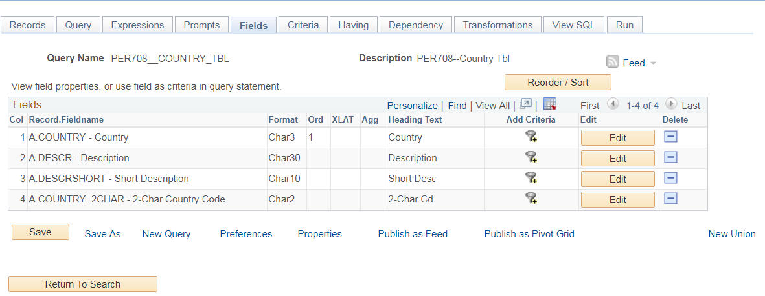
Create a Data Source (Query)

Slide 4
Register the Data Source
Navigate to Reporting Tools > BI Publisher > Data Source and clink on Add New Value.
data source types – Connected Query, PS Query and XML File. From this list of three, we will choose PS Query.
Data Source ID is the name of the query we created in the previous step
Now click Add and fill in the Description and Owner ID
Generate links to generate sample XML data file and the XSD file.
Download the sample XML data file onto your desktop and save

Slide 5
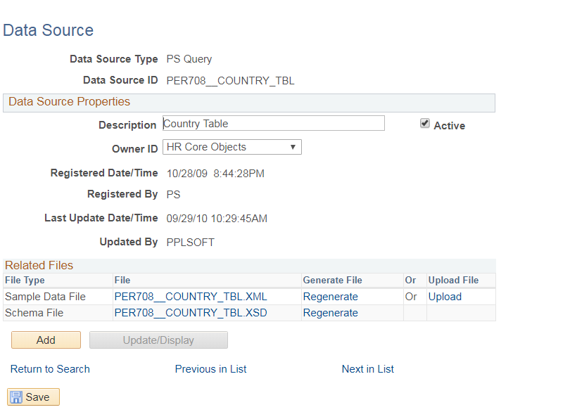
Register the Data Source

Slide 6
Create the Template
create a simple template using XML / BI Publisher design helper for MS Word.
load the xml data file from the previous step
We can add XML tags from list or Table wizard can be used.
Can add text and images and format them.
Before we can preview the template, it should be saved as an RTF file
go to the Preview menu and click on PDF

Slide 7
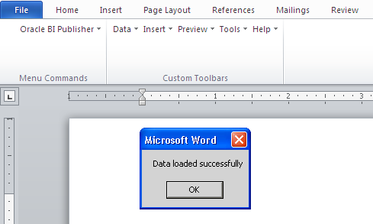
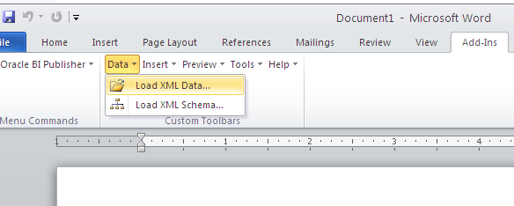
Create the Template

Slide 8
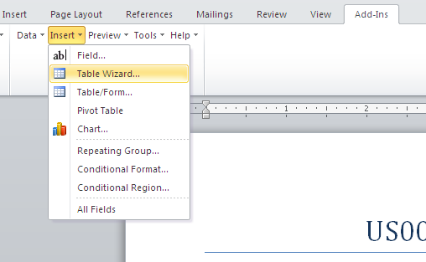
Create the Template

Slide 9
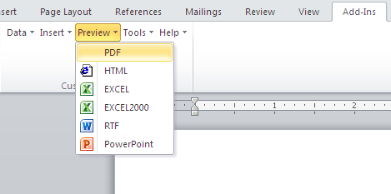
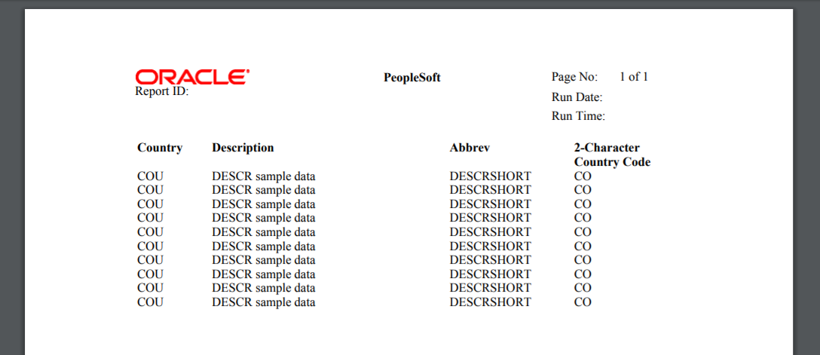
Create the Template

Slide 10
Define the Report Definition
navigate to Reporting Tools > BI Publisher > Report Definition and clink on Add New Value.
Provide a name for the report
Select PS Query from the Data Source Type list.
Select Data Source Id, we created earlier
On the Output page, we just keep the pdf format enabled
Upload the template file and use the Preview button to have a final preview
Save the report definition

Slide 11
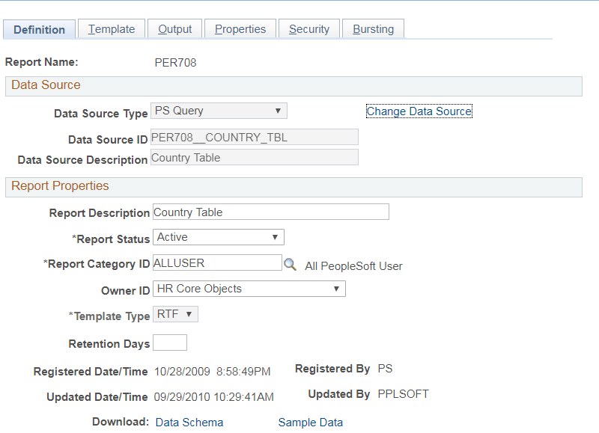
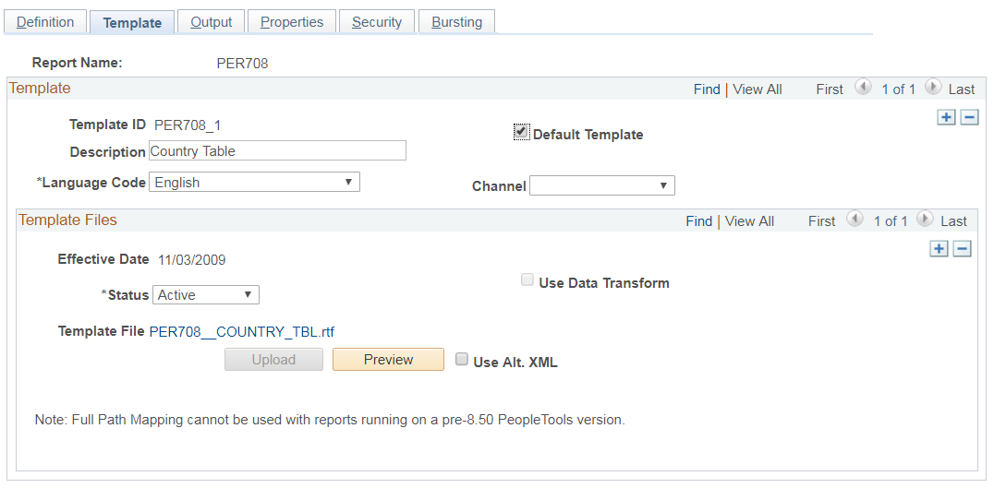
Define the Report Definition

Slide 12
Generating and Scheduling XMLP report
Generating an XMLP Report (Query Report Viewer)
Navigate to Reporting Tools > BI Publisher > Query Report Viewer and search for the report we had created.
Scheduling an XMLP Report (Query Report Scheduler)
navigate to Reporting Tools > BI Publisher > Query Report Scheduler.

Slide 13
Questions ??

Slide 14
THANKS

